Slide 1
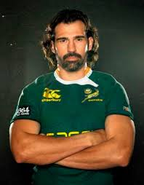
Answering questions

Slide 2
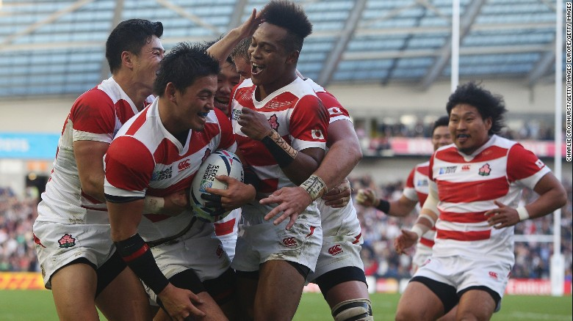
Answering questions

Slide 3
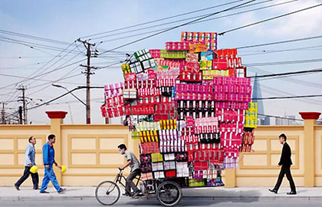
There has to be a better way?

Slide 4
Colossians 1v13-18 – christ’s suPremacy
¹⁴ For he has rescued us from the dominion of darkness and brought us into the kingdom of the Son he loves, ¹⁴ in whom we have redemption, the forgiveness of sins. ¹⁵ The Son (He) is the image of the invisible God, the firstborn over all creation.

Slide 5
Colossians 1v13-18 – christ’s suPremacy
¹⁶ For in him all things were created: things in heaven and on earth, visible and invisible, whether thrones or powers or rulers or authorities; all things have been created through him and for him.
- Primary Cause (plan)
- Instrumental Cause (power)
- Final Cause (purpose)

Slide 6
Colossians 1v13-18 – christ’s suPremacy
¹⁷ He is before all things, and in him all things hold together.
- The beginning
- The sustainer of the universe

Slide 7
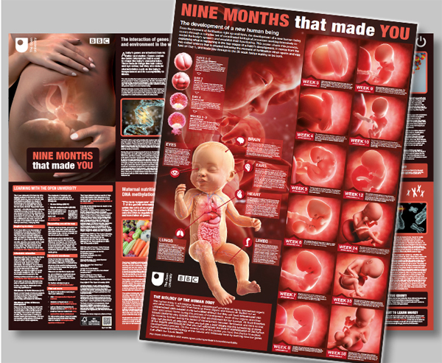

Slide 8
Colossians 1v13-18 – christ’s suPremacy
¹⁸ And he is the head of the body, the church; he is the beginning and the firstborn from among the dead, so that in everything he might have the supremacy.
- Plan
- Power
- Purpose

